Slide 1

Kitronix Halo and Iteration
Lesson 26

Slide 2
What The Lesson Will Cover
Be aware of addressable LEDs
Use iteration
Program the Kitronix Halo

Slide 3
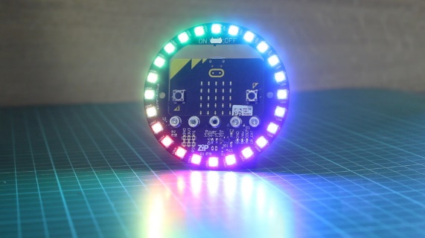
Kitronix Halo
The Halo consists of 24 addressable LEDs, this means that each one can be individual programmed
Each LED can be turned ON or OFF and the colour can be set
The micro:bit uses the neopixel module to control the LEDs – up to 256 of them!
The Halo requires an external power supply with common ground

Slide 4
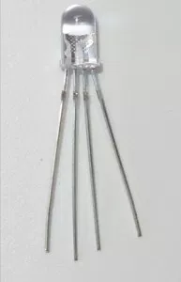
Multi-coloured LEDs
Each LED is a combination of three LEDs
By turning them ON or OFF you can create the colours: red, green and blue
To create other colours a techniques called pulse width modulation, or PWM is used
PWM is a technique for converting analogue signals in to digital, basically ON and OFF
This alters the brightness of the 3 parts of the LED
It is our eyes and our mind then combine these as a particular colour

Slide 5
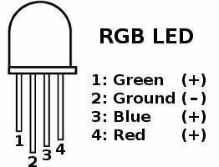
Red Green and Blue (RGB values)
Each LED has three colours: red, green and blue
Each colour can be represented by values 0 and 255, where 0 is OFF and 255 is the maximum amount of colour
The code requires values for all three colours even if they are not used
For example:
The colour red has an RGB value (255, 0, 0)
The colour white has an RGB value (255, 255, 255)
This Photo by Unknown Author is licensed under CC BY-NC-ND

Slide 6
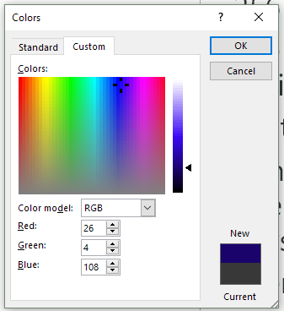
Red Green and Blue (RGB values)
Using these values (0 to 255) means you can create 256 x 256 x 256 combinations or colours
That is 16,777,216 colours (16.7 million)
If the Halo displayed every single colour for one second it would take just over 194 days!
There are many RGB websites that list the common values for different colours

Slide 7
Starter code
from microbit import *
import neopixel
num_of_pix = 24
np = neopixel.NeoPixel(pin0, num_of_pix)
np[0] = (255, 0, 0)
np.show()

Slide 8
Iteration
The previous program uses a single line of code to control each LED
24 LEDs would require at least 24 lines or more of code
This results in redundant code and the program being slow or clunky
A better approach is to use iteration
This is a process where instructions are repeated in a sequence a specified number of times
There are two types of loops in Python, for loops and while loops:
Use a for loop if you want to repeat something a certain number of times
Use a while loop to repeat until something happens, usually a condition is met
Notes:
Discuss with the Learners what Iteration is

Slide 9
Iteration – For
Consider giving every student in your class a bar of chocolate
How do you know when to stop handing out the chocolate?
You stop when every student has a chocolate bar
This is a for loop:
for every student in the class, give them a chocolate bar
Notes:
Discuss with the Learners what Iteration is

Slide 10
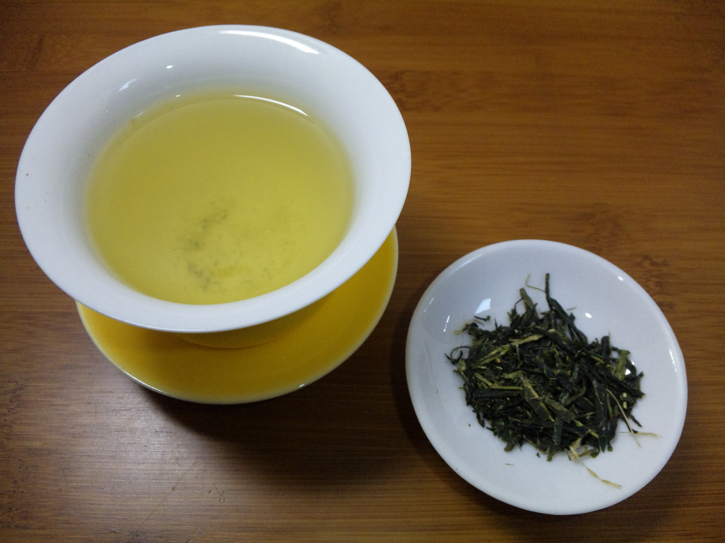
Iteration – While
Consider making a drink of tea in a cup
You fill the cup up until it is full
Or, you fill the cup up while it is empty
This is a while loop:
while the cup is not full, keep pouring the water in
The action of pouring in the water continues until a condition is met.
The ‘condition’ in this example is that the cup is full
When the first set of instructions is executed again, it is called iteration.
This Photo by Unknown Author is licensed under CC BY-SA
Notes:
Discuss with the Learners what Iteration is

Slide 11
Iteration – Examples
Filling up a bucket until it is full
A teacher writing student reports for their class
Reading a book
Reading the first 10 pages of a book
Send a message to your friends inviting them to the cinema
Notes:
Discuss with the Learners what Iteration is
1 – while loop, while the bucket is empty fill it up
2 – for loop, for student in class write a report
3 – while loop, while there are still pages left to read, read them
4 - for loop, for each of the pages read the
5 – for loop

Slide 12
Iteration
Consider setting the first LED to blue and turning it ON
With iteration the program stores the number of LEDs in a variable, np.
When the program runs it uses a for loop to apply the line of code to each of the 24 LEDs
The iteration stops when the code has been applied to the last LED.
An advantage of this method is that if there would 60 LEDs, we simple change the number to 60 on line one.
np = neopixel.NeoPixel(pin0, 24)
while True:
for pixel_id in range(0, len(np)):
Notes:
Discuss with the Learners what Iteration is

